Slide 1
MCP PRESENTATION on
Automatic Railway Gate Control System
2100040069-K.Dinesh Reddy
2100040076-Kowshik
2100040082-Nagendra Mentor:Dr.Aswin Kumer

Slide 2
ABSTRACT
There has been an increase in the road traffic as well as the rail traffic, accidents at level crossing has increased and this has caused the concern for the Indian railways. The objective of this project is to provide an automatic railway gate at a level crossing replacing the gates operated by the gatekeepers. In this project we are proposing a simple solution for the level crossing in which we fix the Ultrasonic sensing system for detect the train. By employing the automatic railway gate control at the level crossing the arrival of the train is detected by the sensors placed near to the gate. Hence, the time for which it is closed is less compared to the manually operated gates.

Slide 3
Objectives
To develop an automated level crossing system.
To reduce human error.
To reduce maintenance cost.
To reduce accident.
To increase the reliability of the level crossing system.
To reduce operation time.

Slide 4
Hardware used in this Project
Arduino Uno
HC-SR04 Ultrasonic Sensor
Servo Motor
Power Supply
Buzzer
Breadboard
Connecting Wires

Slide 5
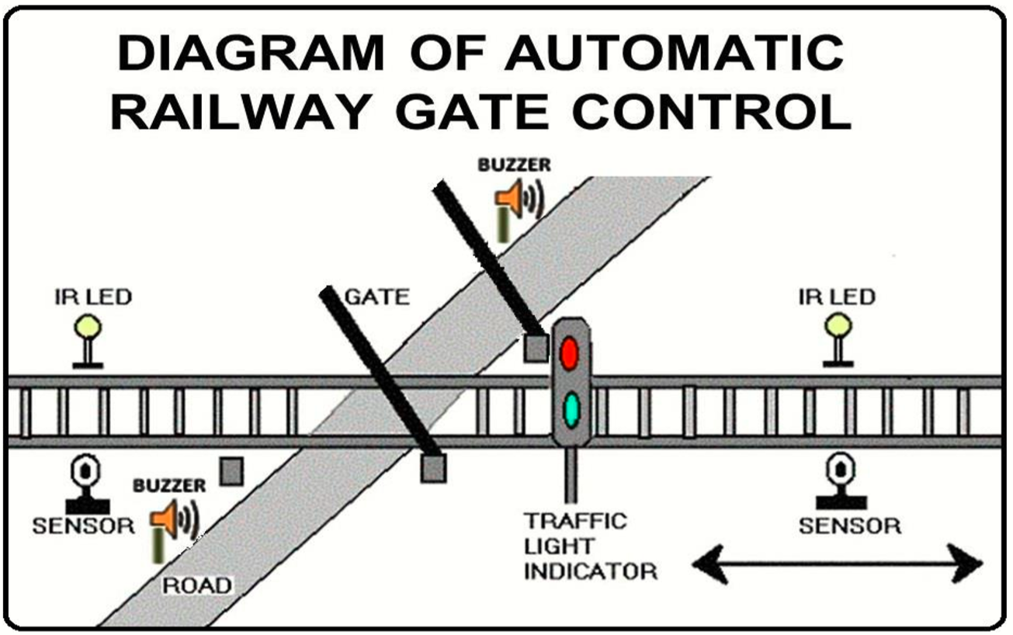

Slide 6
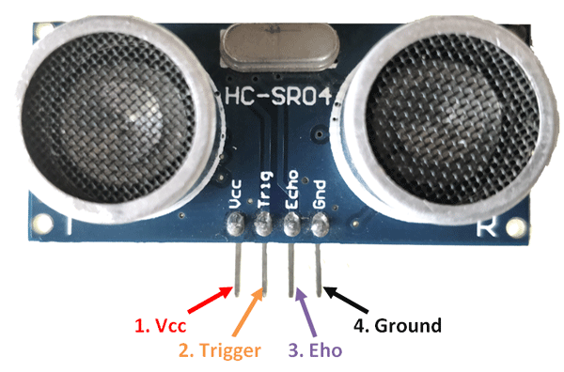
Sensor Used In this Project
Ultrasonic Sensor

Slide 7
Block diagram
Ultrasonic sensor
led
arduino
gate
motor
Ultrasonic sensor
buzzer

Slide 8
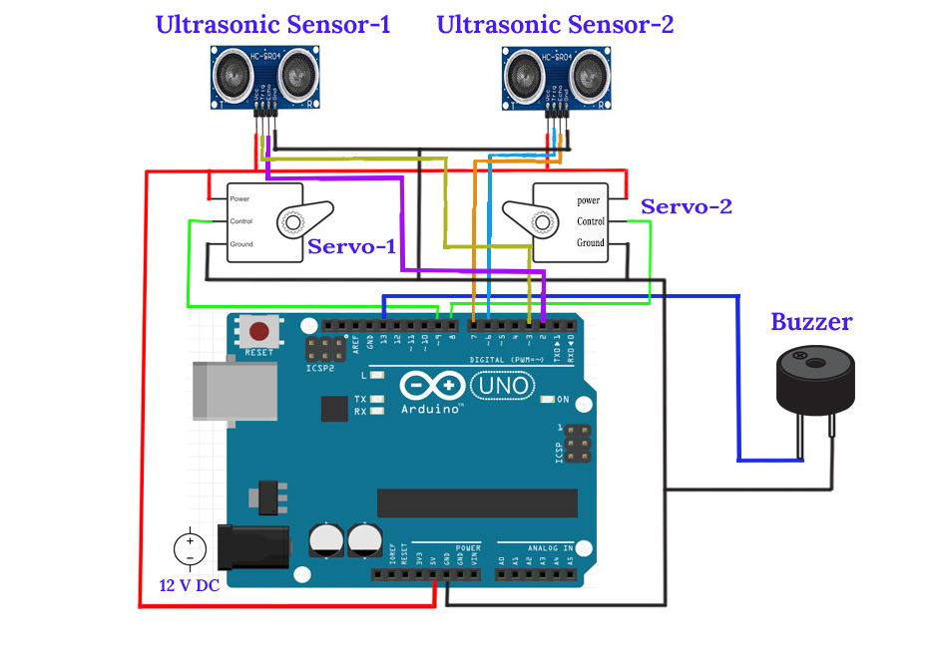
Connection Diagram of the System

Slide 9
Advantages
Prevention of accident inside the gate.
Reduction of the time to wait vehicle.
No need for gatekeeper.
The mechanism of simple and easy to operate.

Slide 10
Conclusion
Automatic gate control system offers an effective way to reduce the occurrence of railway accidents. This system can contribute a lot of benefit either to the road users or to the railway management.

Slide 11
Thank You

